Slide 1
Chapter 1
0
Representing Motion

Slide 2
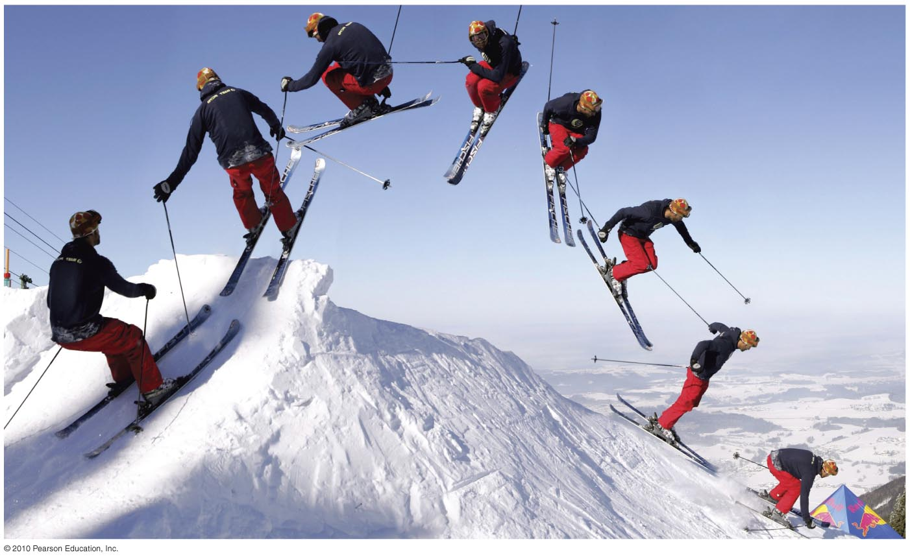


1 Representing Motion
Slide 1-2

Slide 3
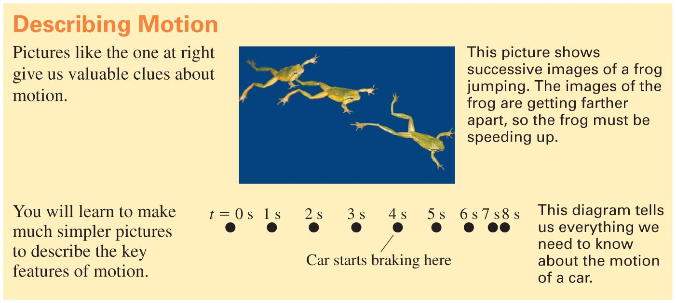
Slide 1-3
Notes:
Answer: B

Slide 4
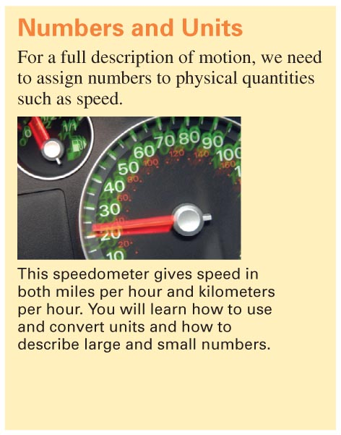
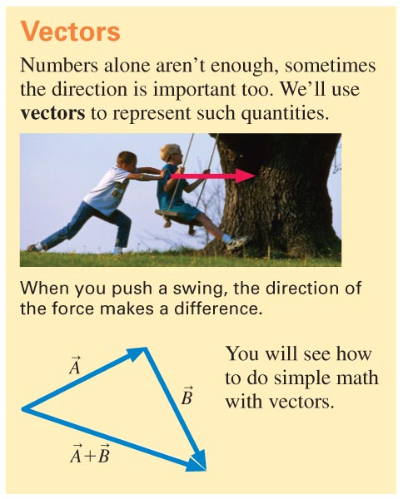
Slide 1-4
Notes:
Answer: B

Slide 5
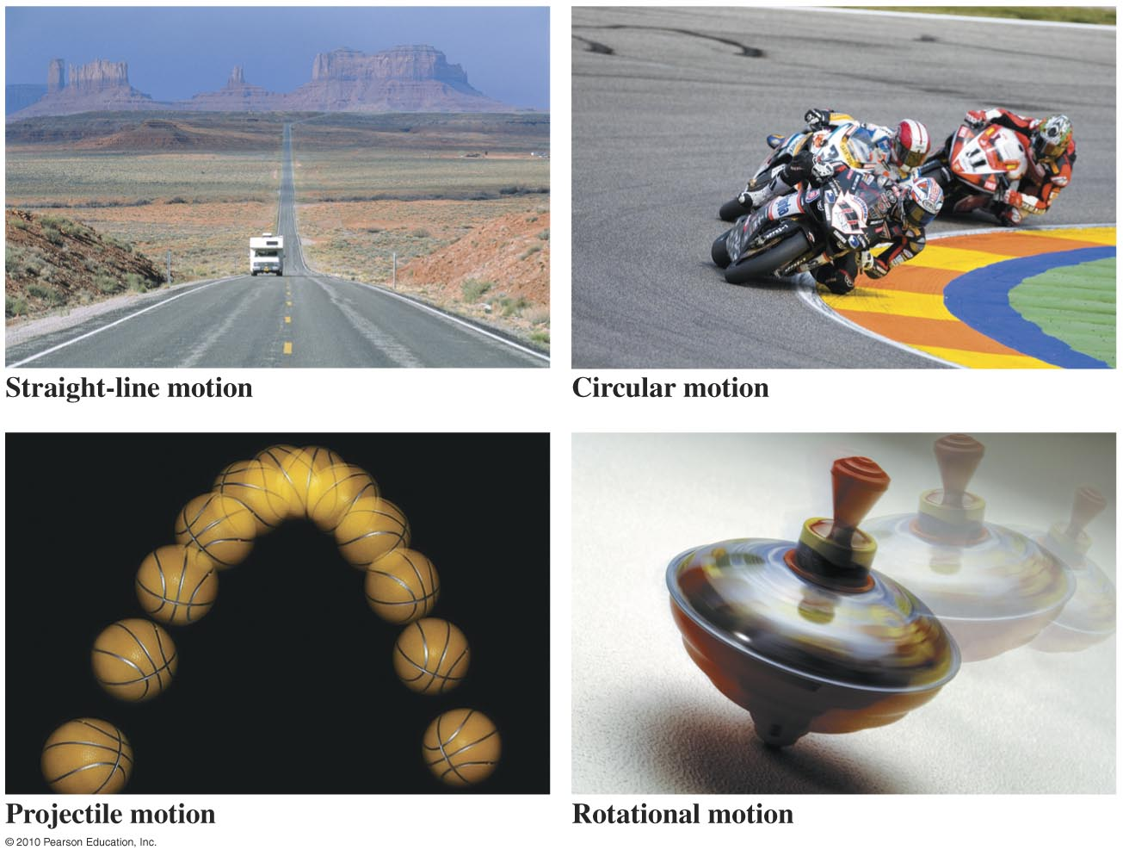
Four Types of Motion We’ll Study
Slide 1-13

Slide 6
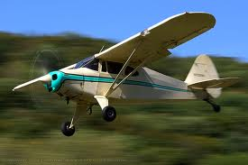
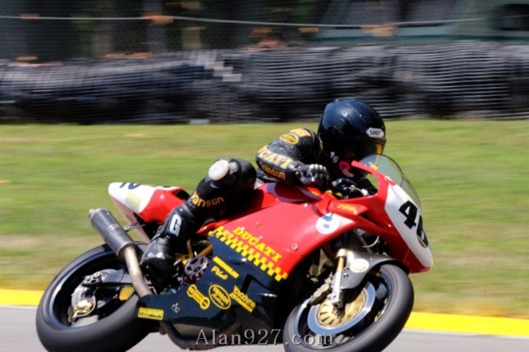
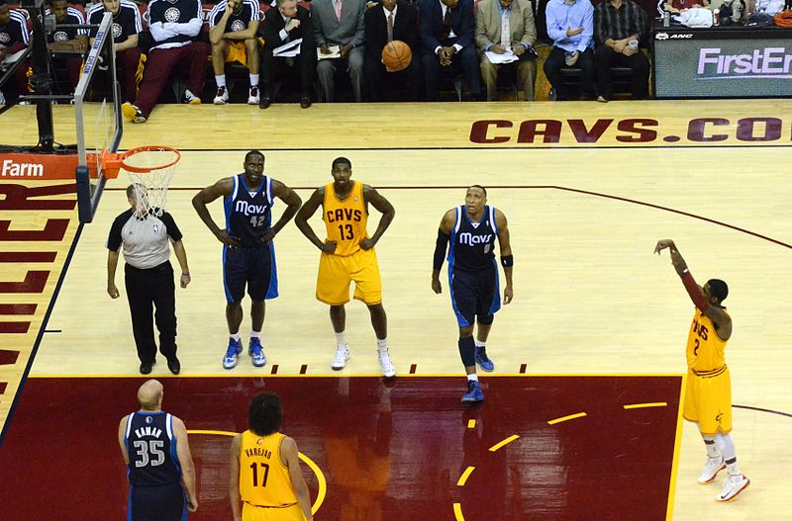
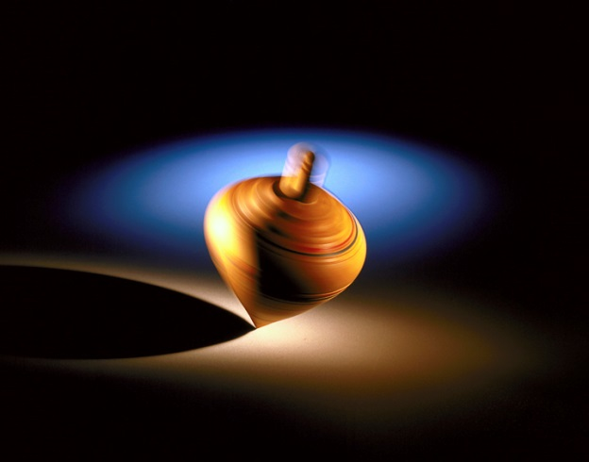
Types of Motion
Uniform Motion
Circular Motion
Projectile Motion
Rotational Motion

Slide 7
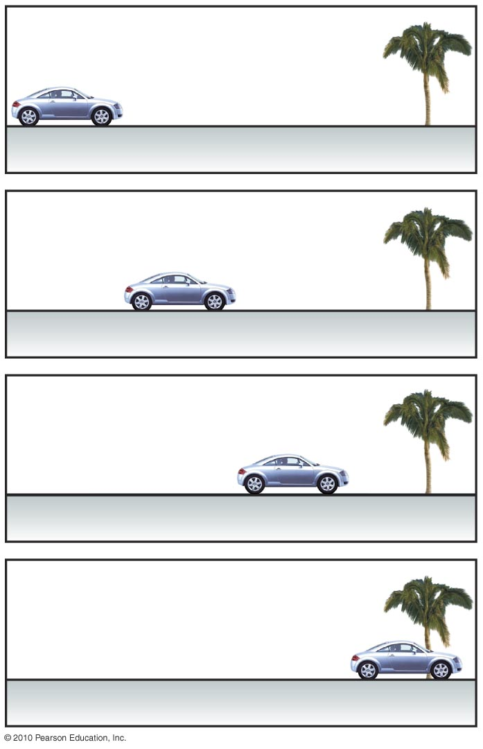
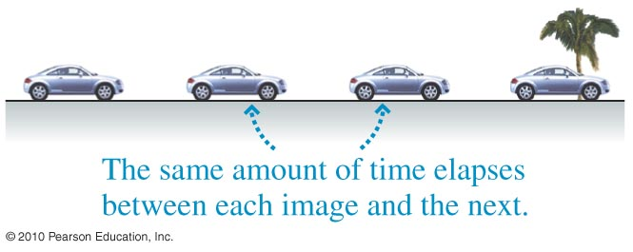
Making a Motion Diagram
Slide 1-14

Slide 8
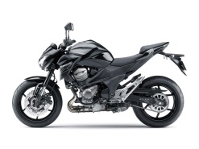
Making a Motion Diagram
Like a camera taking pictures in equal time intervals, i.e. 1 f.p.s.
4 s
3 s
2 s
1 s

Slide 9
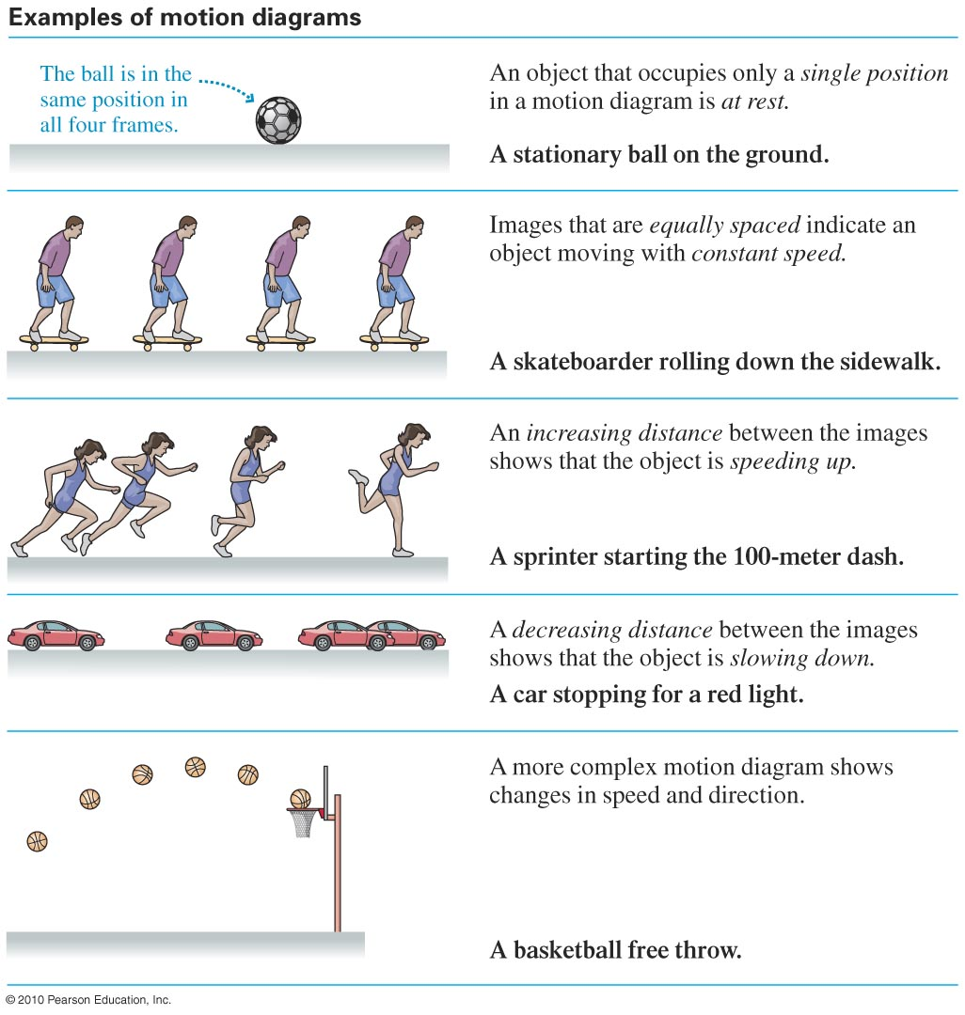
Examples of Motion Diagrams
Slide 1-15

Slide 10
The Particle Model
We treat objects as though they are particles located at the center of mass of the object
300 kg

Slide 11
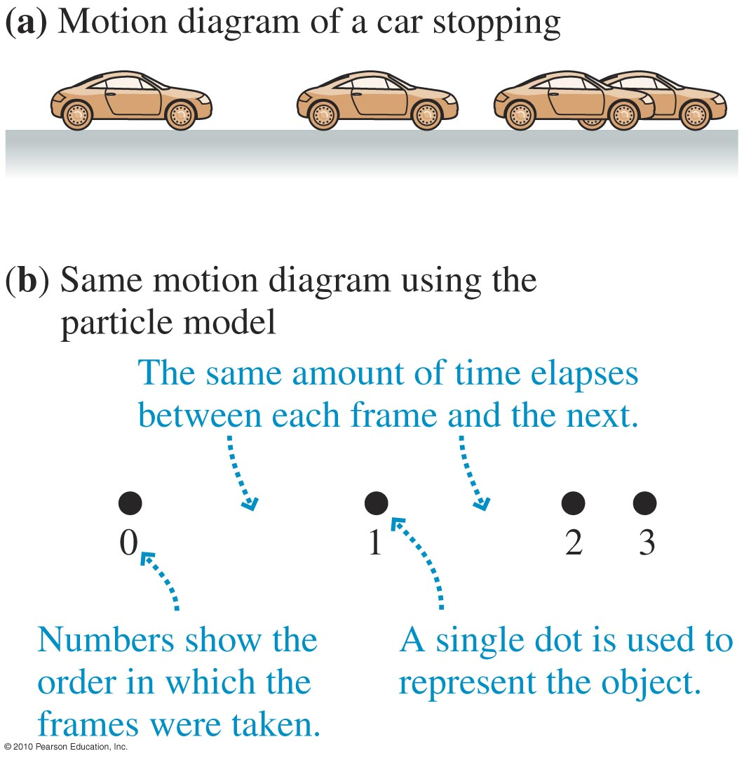
The Particle Model
A simplifying model in which we treat the object as if all its mass were concentrated at a single point. This model helps us concentrate on the overall motion of the object.
Slide 1-16

Slide 12
QQ What kind of motion is a car with cruise control on at 60 mph going straight?
Circular
Uniform
Non-Uniform
Rotational
Accelerated

Slide 13
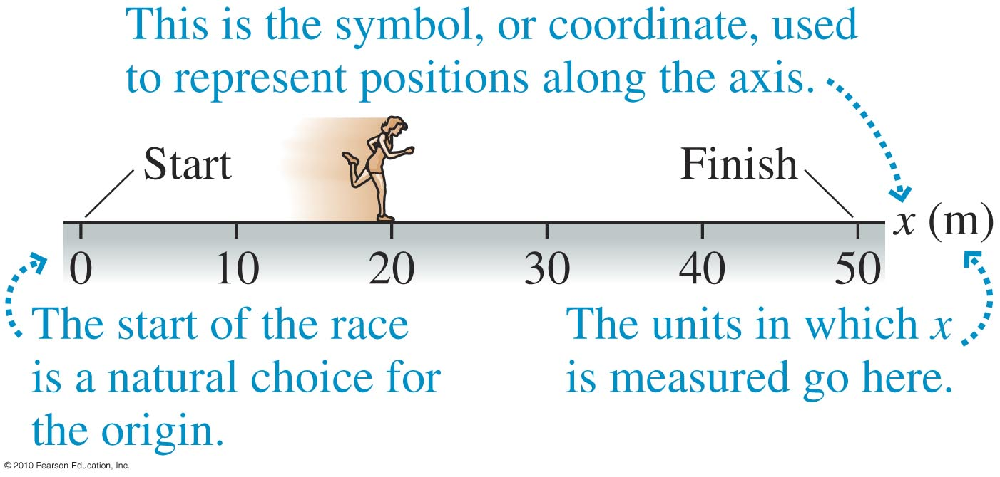
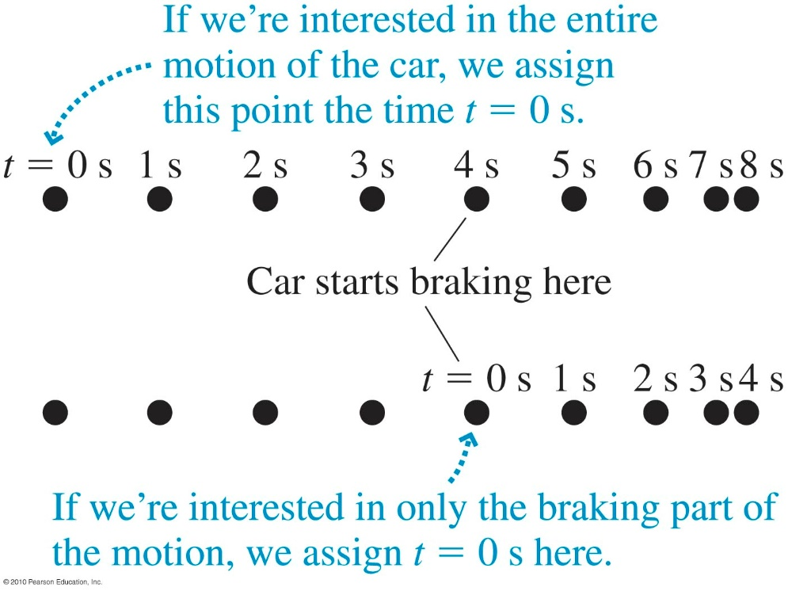
Position and Time
The position of an object is located along a coordinate system.
At each time t, the object is at some particular position. We are free to choose the origin of time (i.e., when t = 0).
Slide 1-17

Slide 14
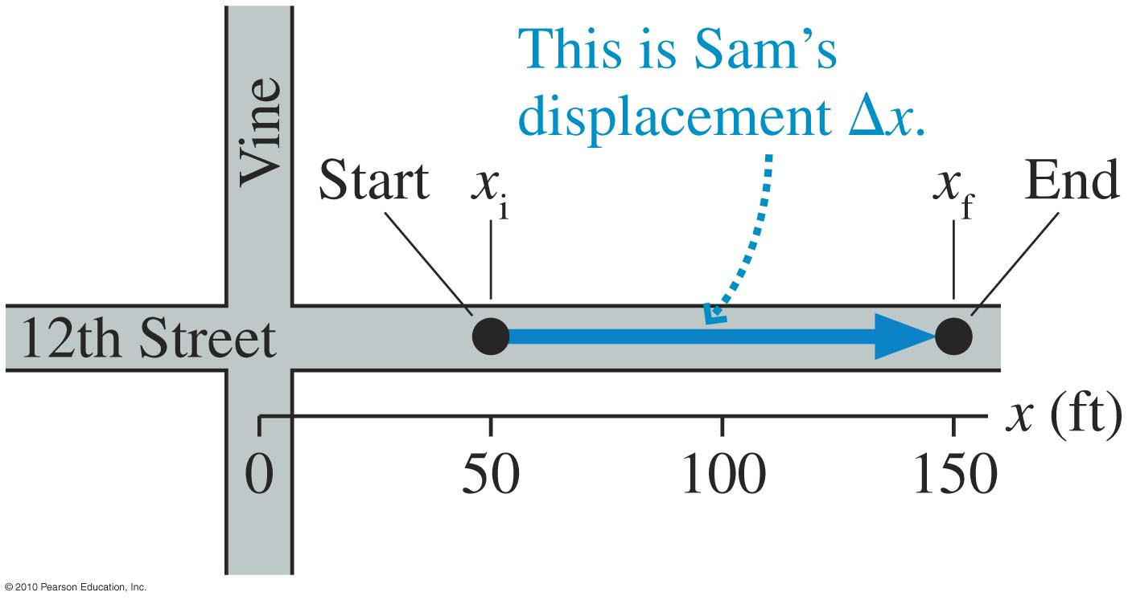
Displacement
The change in the position of an object as it moves from initial position x_{i} to final position x_{f} is its displacement ∆x = x_{f} – x_{i}.
Slide 1-18

Slide 15

Checking Understanding
Maria is at position x = 23 m. She then undergoes a displacement ∆x = –50 m. What is her final position?
–27 m
–50 m
23 m
73 m
Slide 1-19
Notes:
Answer: A

Slide 16
QQ Maria is at position x = 23 m. She then undergoes a displacement ∆x = –50 m. What is her final position?
-27 m
-50 m
23 m
73 m

Slide 17
Answer
Maria is at position x = 23 m. She then undergoes a displacement ∆x = –50 m. What is her final position?
–27 m
–50 m
23 m
73 m
Slide 1-20
Notes:
Answer: A

Slide 18
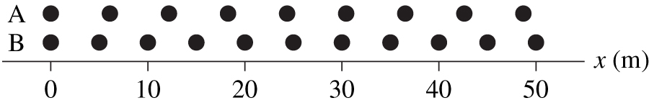
Checking Understanding
Two runners jog along a track. The positions are shown at 1 s time intervals. Which runner is moving faster?
Slide 1-21
Notes:
Answer: A

Slide 19
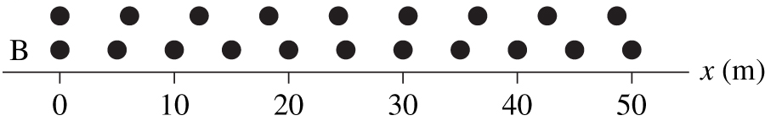
Answer
Two runners jog along a track. The positions are shown at 1 s time intervals. Which runner is moving faster?
A
Slide 1-22
Notes:
Answer: A

Slide 20
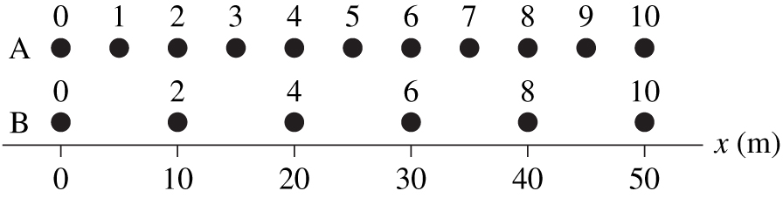
Checking Understanding
Two runners jog along a track. The times at each position are shown. Which runner is moving faster?
They are both moving at the same speed.
Slide 1-23
Notes:
Answer: C

Slide 21
Answer
Two runners jog along a track. The times at each position are shown. Which runner is moving faster?
They are both moving at the same speed.
Slide 1-24
Notes:
Answer: C

Slide 22
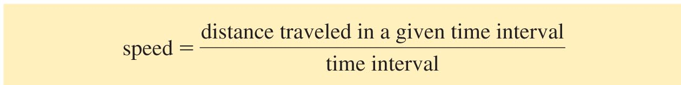
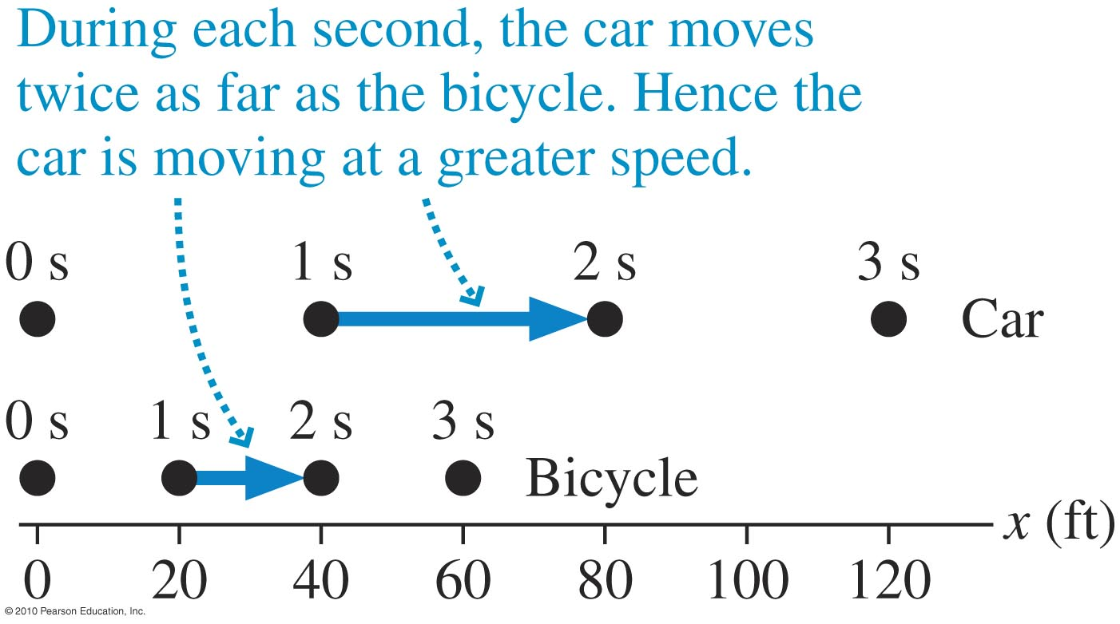
Speed of a Moving Object
40 m
m
The car moves 40 m in 1 s. Its speed is = 40 .
1 s
s
20 m
m
The bike moves 20 m in 1 s. Its speed is = 20 .
1 s
s
Slide 1-25

Slide 23
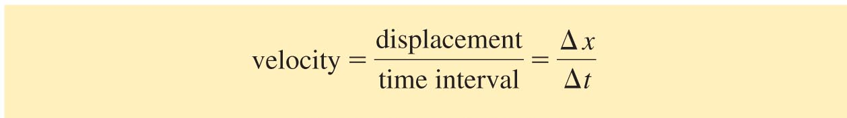
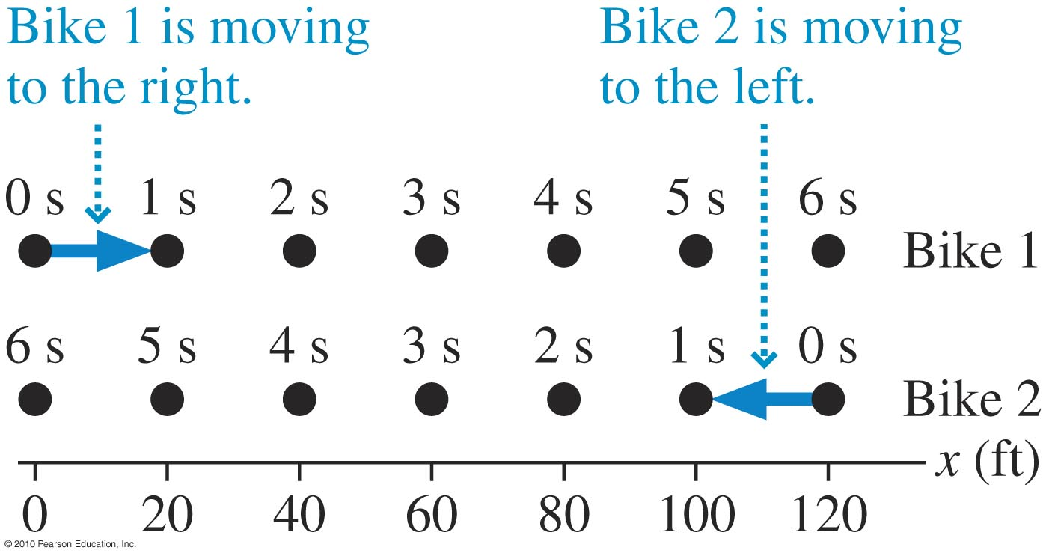
Velocity of a Moving Object
Slide 1-26

Slide 24
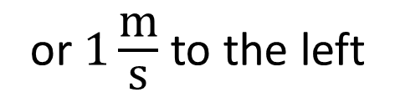
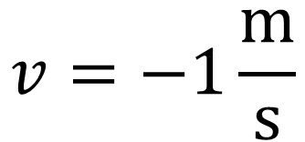
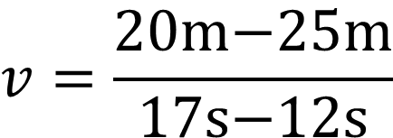

Example Problem
At t = 12 s, Frank is at x = 25 m. 5 s later, he’s at x = 20 m. What is Frank’s velocity?
$$v=\frac{∆x}{∆t}=\frac{x_{\text{f}}−x_{\text{i}}}{t_{\text{f}}−t_{\text{i}}}$$
$$v=\frac{20\text{m}\text{−25}\text{m}}{17\text{s}\text{−12}\text{s}}$$
$$v=−1\frac{\text{m}}{\text{s}}$$
or $1\frac{\text{m}}{\text{s}}$ to the left
t = 17 s
t = 12 s
5
10
15
20
25
x(meters)
Slide 1-27

Slide 25
Position and Coordinate System
An object’s center of mass defines its position
y(meters)
5
10
x(meters)

Slide 26
QQ Where is this motorcycle?
(3m,5m)
(5m,3m)
5m
(4m,1m)
y(meters)
5
10
x(meters)

Slide 27
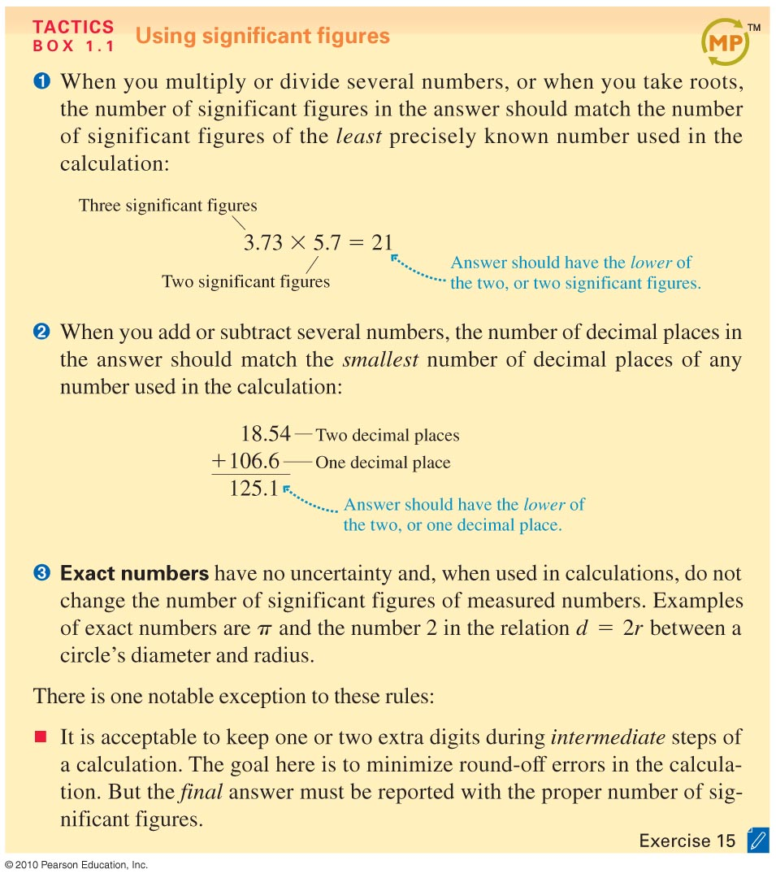
Slide 1-28

Slide 28
Slide 1-29

Slide 29
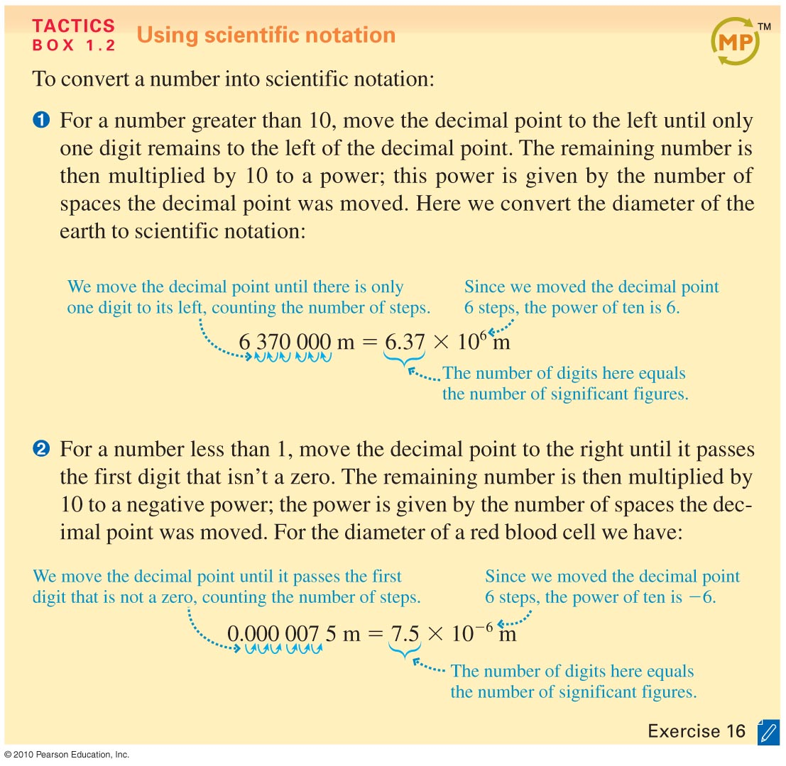
Slide 1-30

Slide 30
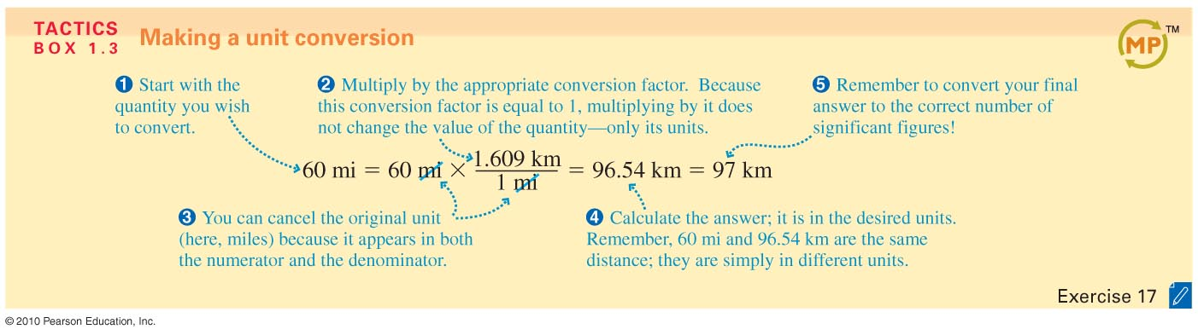
Slide 1-31

Slide 31
Sense of scale
Scientific notation is very handy when comparing numbers
y(parsec)
5
10
x(parsec)
1 parsec = 3.08567758 × 10¹⁶ meters

Slide 32
Precision and Accuracy
Scientific notation is very handy in astrophysics
y(meters)
5
10
x(meters)
Accurate and Precise
1 parsec = 3.1 × 10¹⁶ meters
More Accurate and Precise
1 parsec = 3.08567758 × 10¹⁶ meters

Slide 33
Reading Quiz
The quantity 2.67 x 10³ m/s has how many significant figures?
1
2
3
4
5
Slide 1-7
Notes:
Answer: C

Slide 34
Answer
The quantity 2.67 x 10³ m/s has how many significant figures?
1
2
3
4
5
Slide 1-8
Notes:
Answer: C

Slide 35
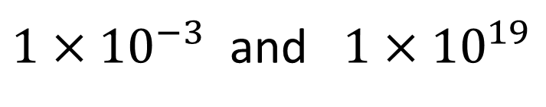
QQ1 What is the difference in order of magnitude between these two numbers?
$1×{10}^{−3}$ and $1×{10}^{19}$
4
16
22
11

Slide 36
Precision vs. Accuracy
Shooting range
Accurate
Precise not Accurate

Slide 37
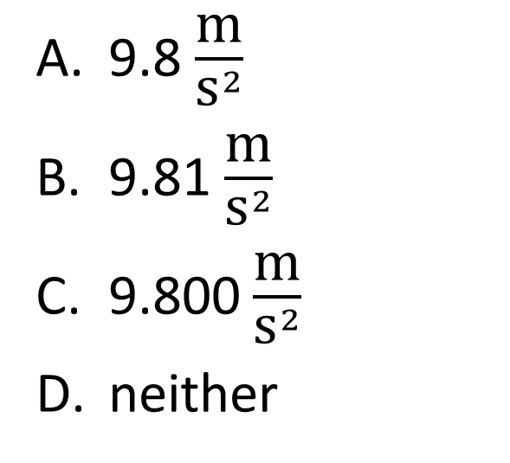
QQ2 Which value is more precise?
9.8 $\frac{\text{m}}{{\text{s}}^{2}}$
9.81 $\frac{\text{m}}{{\text{s}}^{2}}$
9.800 $\frac{\text{m}}{{\text{s}}^{2}}$
neither

Slide 38
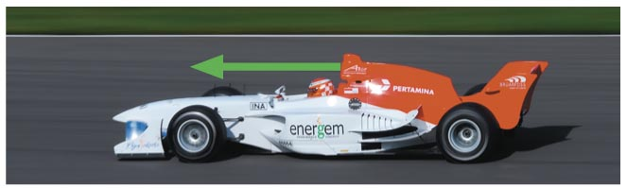
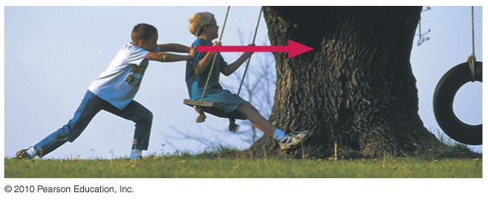
Vectors
A quantity that requires both a magnitude (or size) and a direction can be represented by a vector. Graphically, we represent a vector by an arrow.
The velocity of this car is 100 m/s (magnitude) to the left (direction).
This boy pushes on his friend with a force of 25 N to the right.
Slide 1-32

Slide 39
Reading Quiz
Velocity vectors point
in the same direction as displacement vectors.
in the opposite direction as displacement vectors.
perpendicular to displacement vectors.
in the same direction as acceleration vectors.
Velocity is not represented by a vector.
Slide 1-11
Notes:
Answer: A

Slide 40
Answer
Velocity vectors point
in the same direction as displacement vectors.
in the opposite direction as displacement vectors.
perpendicular to displacement vectors.
in the same direction as acceleration vectors.
Velocity is not represented by a vector.
Slide 1-12
Notes:
Answer: A

Slide 41
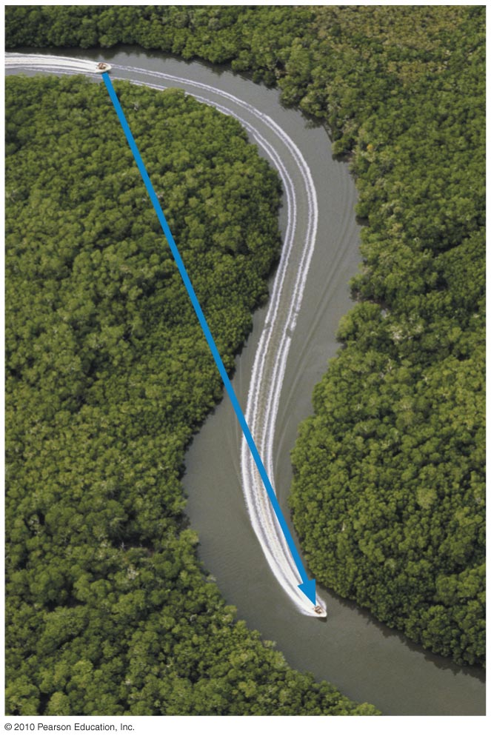
Displacement Vectors
A displacement vector starts at an object’s initial position and ends at its final position. It doesn’t matter what the object did in between these two positions.
In motion diagrams, the displacement vectors span successive particle positions.
Slide 1-33

Slide 42
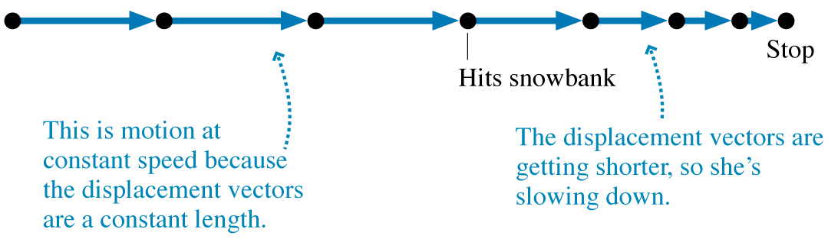
Exercise
Alice is sliding along a smooth, icy road on her sled when she suddenly runs headfirst into a large, very soft snowbank that gradually brings her to a halt. Draw a motion diagram for Alice. Show and label all displacement vectors.
Slide 1-34

Slide 43
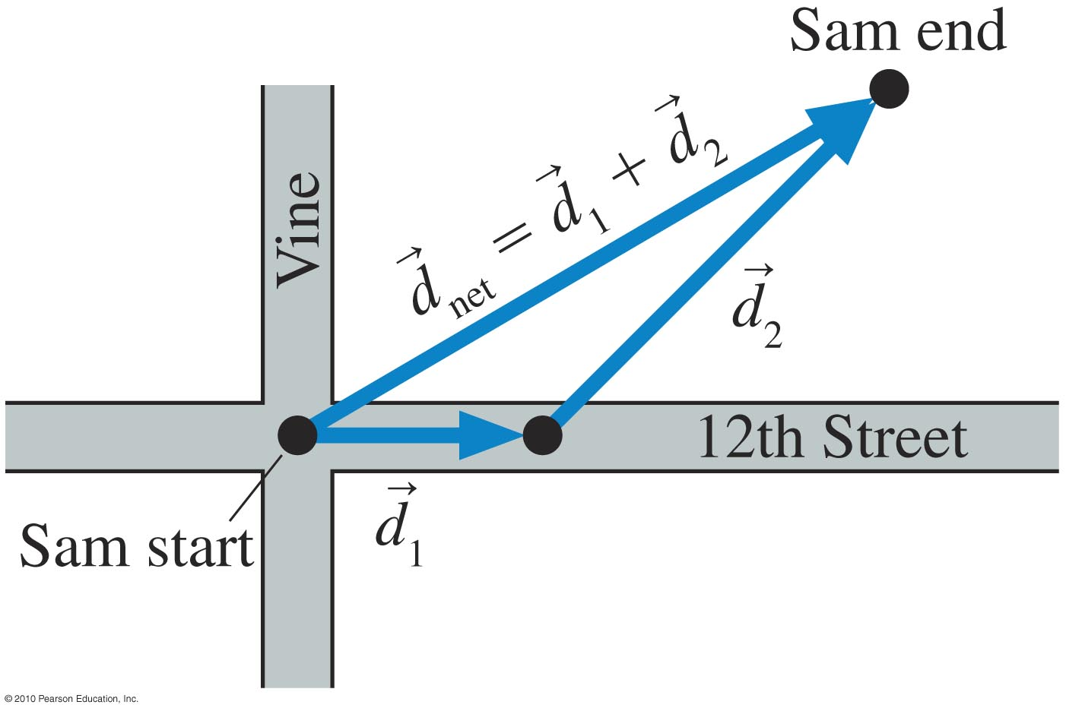
Adding Displacement Vectors
Slide 1-35

Slide 44
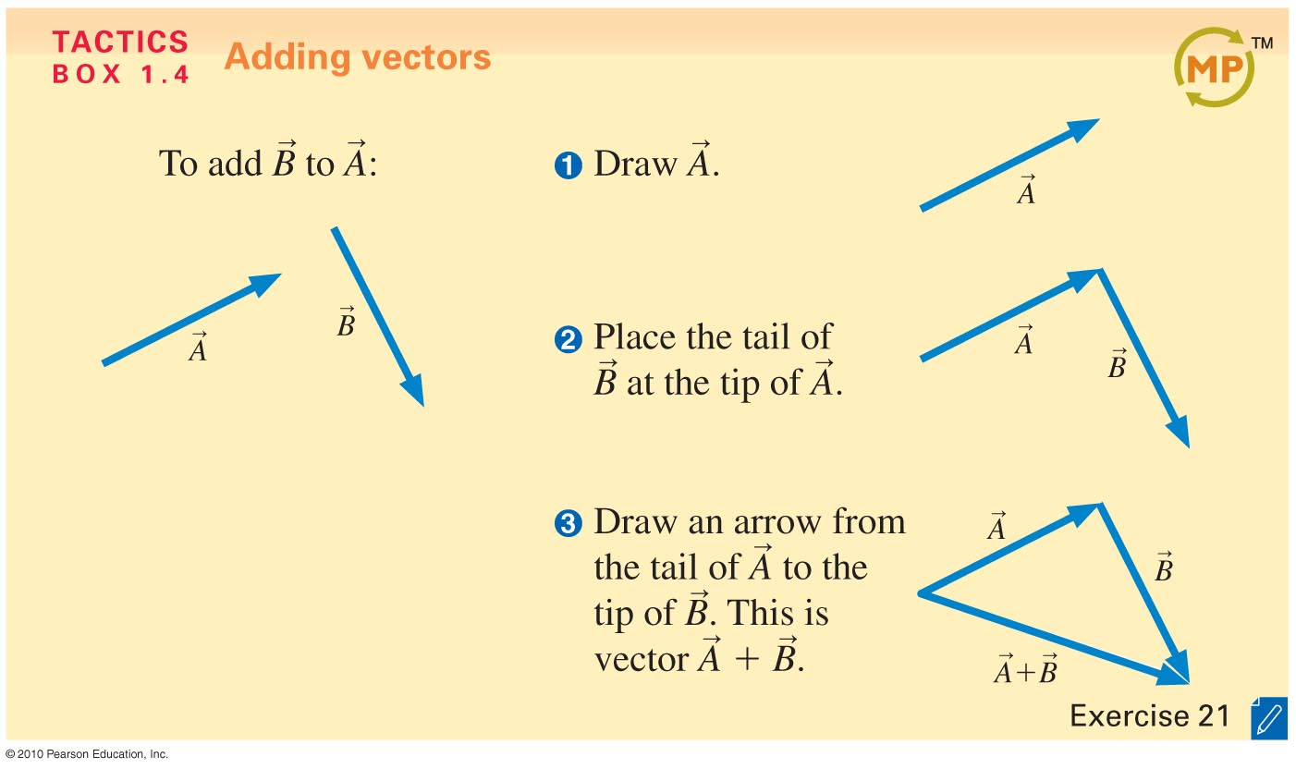
Slide 1-36

Slide 45
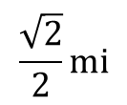

Example Problem: Adding Displacement Vectors
Jenny runs 1 mi to the northeast, then 1 mi south. Graphically find her net displacement.
A square
1 mi
$${45}^{°}$$
$$\frac{\sqrt{2}}{2}\text{mi}$$
1 mi
Slide 1-37

Slide 46

Example Problem: Adding Displacement Vectors
Jenny runs 1 mi to the northeast, then 1 mi south. Graphically find her net displacement.
About ¾ of a mile!
Now compare with math
1 mi
$${45}^{°}$$
1 mi
½ mi
$\sim$¼ mi
Slide 1-37

Slide 47
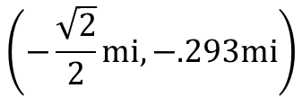
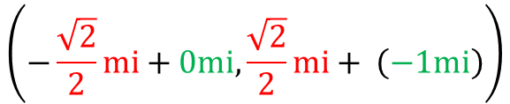
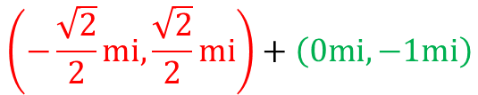

Example Problem: Adding Displacement Vectors
Jenny runs 1 mi to the northeast, then 1 mi south. Graphically find her net displacement.
About ¾ of a mile!
Now compare with math
A square
1 mi
$$\left(−\frac{\sqrt{2}}{2}\text{mi}, \frac{\sqrt{2}}{2}\text{mi}\right)+\left(0\text{mi},−1\text{mi}\right)$$
$${45}^{°}$$
1 mi
$$\left(−\frac{\sqrt{2}}{2}\text{mi}+0\text{mi}, \frac{\sqrt{2}}{2}\text{mi}+ \left(−1\text{mi}\right)\right)$$
$$\left(−\frac{\sqrt{2}}{2}\text{mi}, −.293\text{mi}\right)$$
net displacement $=75\sqrt{{\left(−\frac{\sqrt{2}}{2}\text{mi}\right)}^{2}+{\left(−.293\text{mi}\right)}^{2}}=\text{0.765367}\text{mi} \sim .75\text{mi}$
Slide 1-37

Slide 48
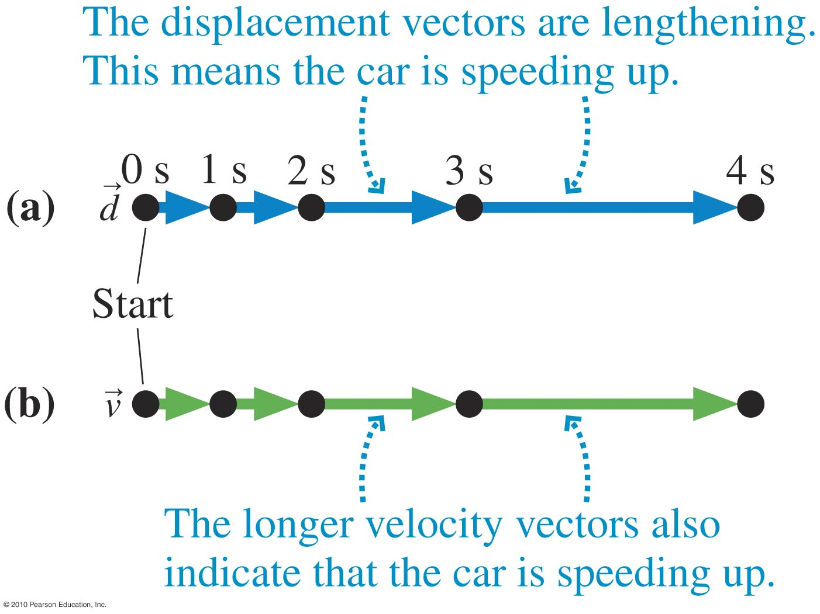
Velocity Vectors
Slide 1-38

Slide 49
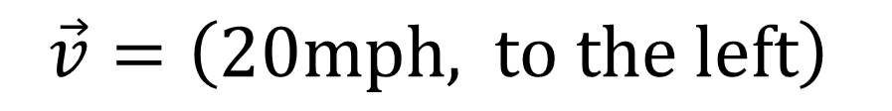
Velocity
Speed and direction
y(meters)
$$\vec{v}=\left(20\text{mph}\text{, }\text{to} \text{the} \text{left}\right)$$
20mph
20mph
20mph
5
10
x(meters)

Slide 50
Reading Quiz
If Sam walks 100 m to the right, then 200 m to the left, his net displacement vector points
to the right.
to the left.
has zero length.
Cannot tell without more information.
Slide 1-9
Notes:
Answer: B

Slide 51
Answer
If Sam walks 100 m to the right, then 200 m to the left, his net displacement vector points
to the right.
to the left.
has zero length.
Cannot tell without more information.
Slide 1-10
Notes:
Answer: B

Slide 52
QQ What is velocity?
The speed of an object in motion
The momentum of an object
The speed and direction of an object in motion
The rate-of-change of speed of an object

Slide 53
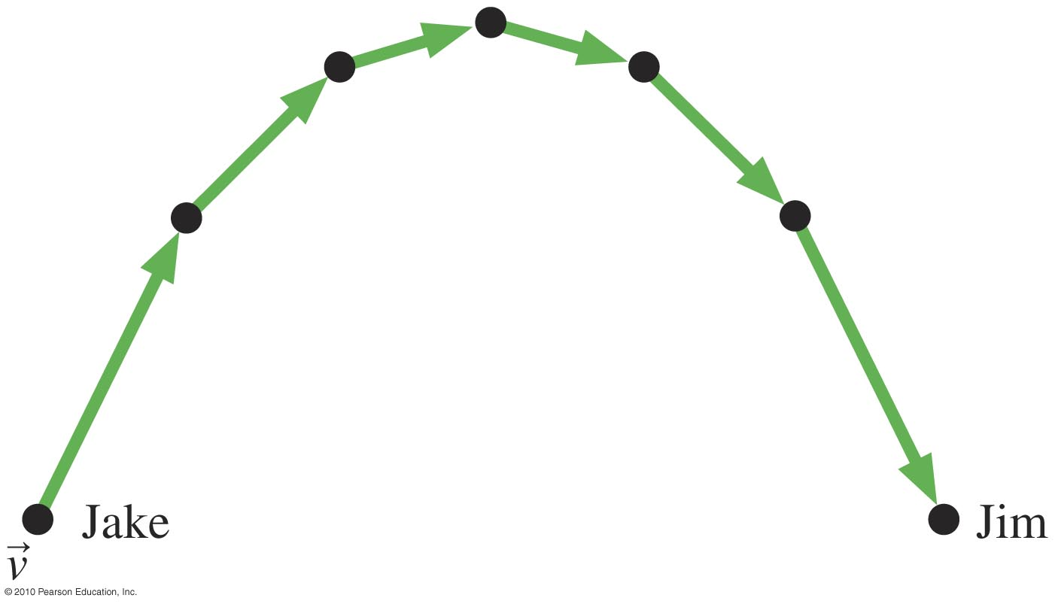
Example: Velocity Vectors
Jake throws a ball at a 60° angle, measured from the horizontal. The ball is caught by Jim. Draw a motion diagram of the ball with velocity vectors.
Slide 1-39

Slide 54
Which value is more accurate?
9.8 $\frac{\text{m}}{{\text{s}}^{2}}$
9.81 $\frac{\text{m}}{{\text{s}}^{2}}$
9.800 $\frac{\text{m}}{{\text{s}}^{2}}$
neither

Slide 55
Vectors
A vector has magnitude and direction
Ex: The velocity vector for this particle has a magnitude(speed in this case) of 10 m/s and a direction of west or 180 degrees
y(meters)
10 m/s
10 m/s
10 m/s
5
10
x(meters)

Slide 56
Reading Quiz
What is the difference between speed and velocity?
Speed is an average quantity while velocity is not.
Velocity contains information about the direction of motion while speed does not.
Speed is measured in mph, while velocity is measured in m/s.
The concept of speed applies only to objects that are neither speeding up nor slowing down, while velocity applies to every kind of motion.
Speed is used to measure how fast an object is moving in a straight line, while velocity is used for objects moving along curved paths.
Slide 1-5
Notes:
Answer: B

Slide 57
Answer
What is the difference between speed and velocity?
Speed is an average quantity while velocity is not.
Velocity contains information about the direction of motion while speed does not.
Speed is measured in mph, while velocity is measured in m/s.
The concept of speed applies only to objects that are neither speeding up nor slowing down, while velocity applies to every kind of motion.
Speed is used to measure how fast an object is moving in a straight line, while velocity is used for objects moving along curved paths.
Slide 1-6
Notes:
Answer: B

Slide 58
QQ What is your velocity vector if your traveling to Salt Lake City from here?
70 mph
North
70 mph North
70 mph South

Slide 59
Vector Addition
Throw a ball forward wall running forward
y(meters)
Speed of ball relative to ground
5
10
x(meters)

Slide 60


Foraging bees often move in straight lines away from and toward their hives. Suppose a bee starts at its hive and flies 650m due east, then flies 390m west, then 670m east. How far away from home did it get?
$$650\text{m}\text{−390}\text{m}\text{+670}\text{m}\text{=930}\text{m}$$

Slide 61
QQ Joe Namath back pedals from the line of scrimmage at 3 m/s. He then throws the ball forward at 20 m/s relative to himself to Jerry Rice who is running 10 m/s forward. How fast is the ball moving relative to Jerry?
17 m/s
13 m/s
27 m/s
7 m/s

Slide 62

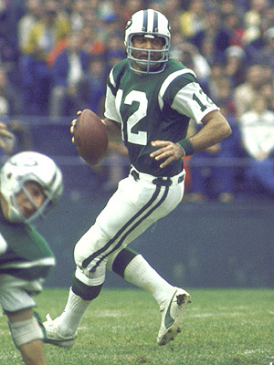
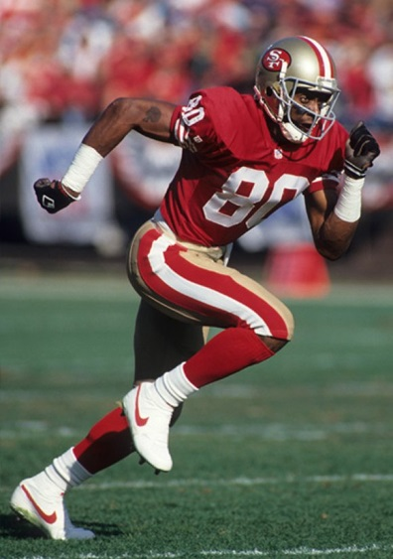
The perfect pass play
20 m/s
10 m/s
3 m/s

Slide 63
The perfect pass play
-3 m/s + 20 m/s = 17 m/s
3 m/s
20 m/s
The ball is moving forward at 17 m/s relative to the ground

Slide 64
The perfect pass play
17 m/s - 10 m/s = 7 m/s
10 m/s
17 m/s
17 m/s
10 m/s
7 m/s
The ball is moving forward at 7 m/s relative to Jerry using vector subtraction

Slide 65
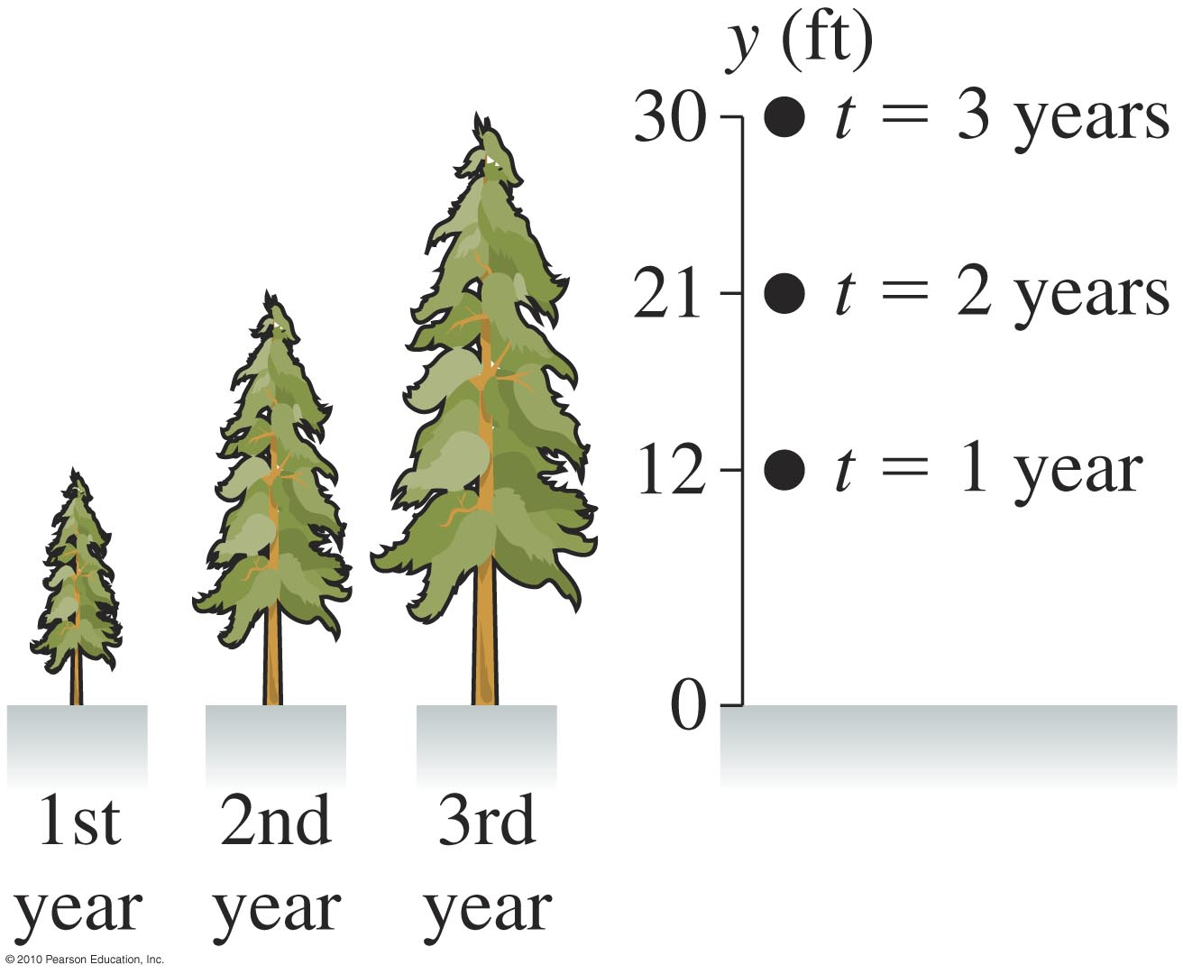

MCAT style question
What is the tree’s speed of growth, in feet per year, from $t=1\text{yr}$ to $t=3\text{yr}$ ?
12 ft/yr
9 ft/yr
6 ft/yr
3 ft/yr

Slide 66

MCAT style question
What is the speed in m/s?
$9×{10}^{−8}\text{m}\text{/}\text{s}$
$3×{10}^{−9}\text{m}\text{/}\text{s}$
$5×{10}^{−6}\text{m}\text{/}\text{s}$
$2×{10}^{−6}\text{m}\text{/}\text{s}$

Slide 67


MCAT style question
At the end of year 3, a rope is tied to the very top of the tree to steady it. This rope is staked to the ground 15 feet away from the tree. What angle does the rope make with the ground?
${63}^{∘}$
${60}^{∘}$
${30}^{∘}$
${27}^{∘}$

